Slide 1
Database Modeling
Introduction
Notes:
1
20483C
1: Review of Visual C# Syntax

Slide 2
Process
Requirement analysis
Create ER-diagram
Organizing data into tables
Normalizing
Notes:
2
20483C
1: Review of Visual C# Syntax

Slide 3

Requirement analysis
Gather information
List the types of data
Notes:
Gather information:
- Interview the people who will use it
- Analyze business forms, such as invoices, timesheets, surveys
- Comb through any existing data systems (including physical and digital files)
List the types of data (entities):
- People (e.g Customer)
- Things (e.g Computer)
- Locations (e.g Address)
- Events (e.g Order)
3
20483C
1: Review of Visual C# Syntax

Slide 4

ER-Diagram
Visual
Entities
Primary keys
Cardinality
Notes:
Create ER-diagram:
- Visual overview of the database
- Entities with attributes (e.g Student with attributes StudentID, Birthdate, GradeLevel)
- Decide primary key
- Identiy the cardinality
4
20483C
1: Review of Visual C# Syntax

Slide 5

Organizing data into tables
ER-diagram => tables
Assign datatypes
Notes:
Convert the ER-diagram to tables
Assign datatypes:
- char
- varchar
- text
- int
- flout, double, decimal
- binary data
5
20483C
1: Review of Visual C# Syntax

Slide 6

Normalization
One big => many small
Notes:
Normalization is good for databases where data is to be created, read, updated and deleted. (OLTP)
Normalization is not good when you just have to read data - eg analyze data or create reports. It can degrade performance.
Normalization. One big table (with redundant data) => many small tables
6
20483C
1: Review of Visual C# Syntax

Slide 7
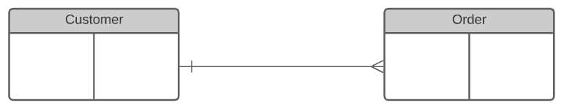
Relations
Notes:
For ER-Diagram: you need to figure out relationships between entities
Usual 1 to many. Or many to 1. Or many to many
Sometimes 1 to 1.
Could be:
3 to 7
0..1 to 1
How’s the relation between customers and orders?
One customer can place many orders
One order is placed by only one customer (can’t be shared)
7
20483C
1: Review of Visual C# Syntax

Slide 8
Relations
Notes:
One customer places many orders
8
20483C
1: Review of Visual C# Syntax

Slide 9
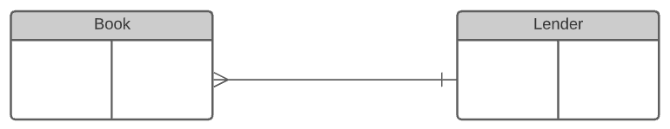
Relations
Notes:
(not so good example)
A book might at a specific time be lend by 0 or 1 lender
At a specific time a lender might have many books
9
20483C
1: Review of Visual C# Syntax

Slide 10
Relations
Notes:
(not so good example)
A book might at a specific time be lend by 0 or 1 lender
At a specific time a lender might have many books
10
20483C
1: Review of Visual C# Syntax

Slide 11
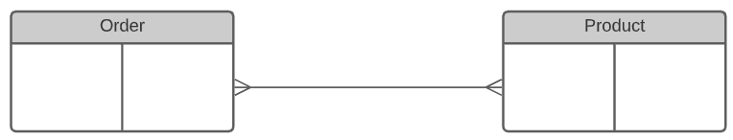
Relations
Notes:
11
20483C
1: Review of Visual C# Syntax

Slide 12
Relations
Notes:
12
20483C
1: Review of Visual C# Syntax

Slide 13
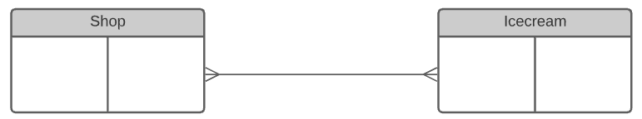
Relations
Notes:
13
20483C
1: Review of Visual C# Syntax

Slide 14
Relations
Notes:
14
20483C
1: Review of Visual C# Syntax

Slide 15
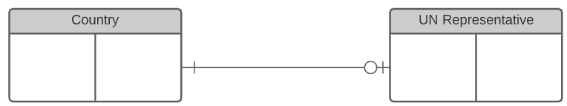
Relations
Notes:
15
20483C
1: Review of Visual C# Syntax

Slide 16
Relations
Notes:
16
20483C
1: Review of Visual C# Syntax

Slide 17
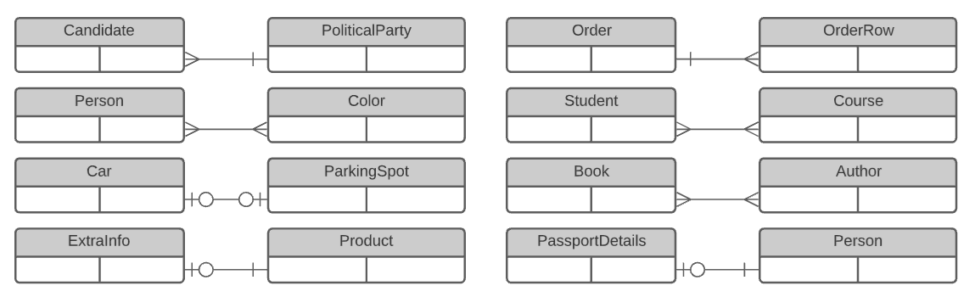
Relations
Notes:
Exercise in groups!
Divide 1-2 relations to each group
Use https://www.lucidchart.com/ or draw.io
20min
17
20483C
1: Review of Visual C# Syntax

Slide 18
Relations
Notes:
18
20483C
1: Review of Visual C# Syntax

Slide 19
Normalizing
First normal form
Second normal form
Third normal form
Notes:
There are three common forms of database normalization: 1st, 2nd, and 3rd normal form. They are also abbreviated as 1NF, 2NF, and 3NF respectively.
There are several additional forms, such as BCNF, but I consider those advanced, and not too necessary to learn in the beginning.
The forms are progressive, meaning that to qualify for 3rd normal form a table must first satisfy the rules for 2nd normal form, and 2nd normal form must adhere to those for 1st normal form.
There are three main reasons to normalize a database. The first is to minimize duplicate data, the second is to minimize or avoid data modification issues, and the third is to simplify queries.
https://www.essentialsql.com/get-ready-to-learn-sql-database-normalization-explained-in-simple-english/
19
20483C
1: Review of Visual C# Syntax

Slide 20
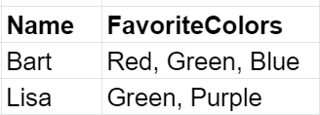
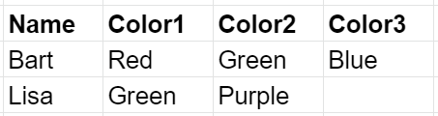
Normalizing
First normal form
Notes:
A cell must have only one value
A group of fields is also not good (ex Color1, Color2, Color3)
Both examples breaks the 1st normal form
Solution: divide into multiple tables (or multiple columns)
20
20483C
1: Review of Visual C# Syntax

Slide 21

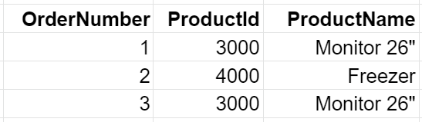
Normalizing
Second normal form
Notes:
All columns depend on the primary key. (Not only part of a primary key.)
You can only break second normal form if you have more than one primary key.
The example violates 2NF because the product name *does not* depend on the order number.
Solution: delete "Product name" (move it to the product table)
“I like to think the reason we place tables in 2nd normal form is to narrow them to a single purpose. ”
About column relation to primary key.
21
20483C
1: Review of Visual C# Syntax

Slide 22
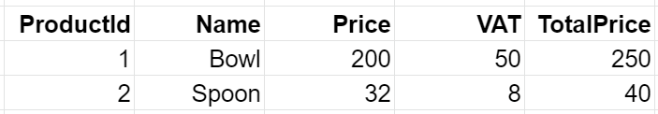
Normalizing
Third normal form
Notes:
All columns (which are not keys) should be independent of the others.
The example violates 3NF because
VAT is dependent on "Price" (and can be calculated by it)
TotalPrice is dependent on Price and VAT
Solution: remove TotalPrice. Do this calculation in your program instead (C#). You can also save the VAT-percentage in the database
https://www.essentialsql.com/get-ready-to-learn-sql-11-database-third-normal-form-explained-in-simple-english/
22
20483C
1: Review of Visual C# Syntax

